Slide 1
Exercises

Slide 2
E3: Use of materials selection charts
E4: Translation: constraints and objectives
E5: Deriving and using material indices
E7: Multiple constraints and objectives

Slide 3
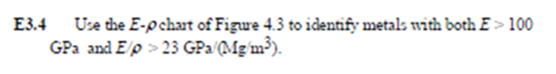
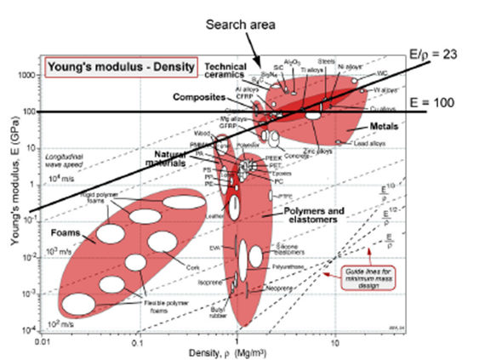
E3: Use of materials selection charts

Slide 4
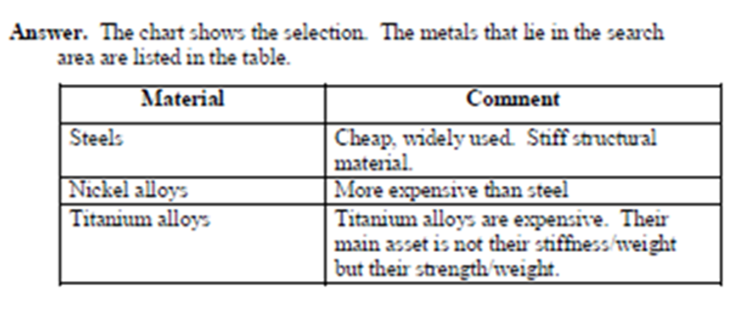

Slide 5
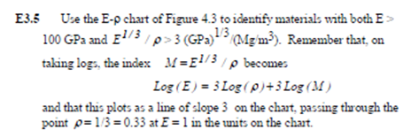
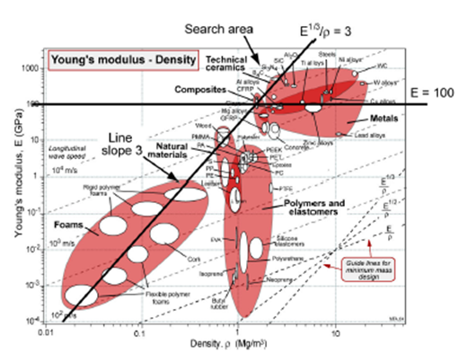

Slide 6
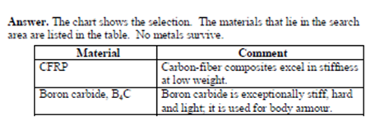

Slide 7
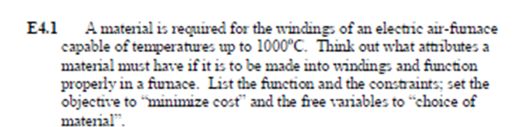
E4: Translation: constraints and objectives

Slide 8
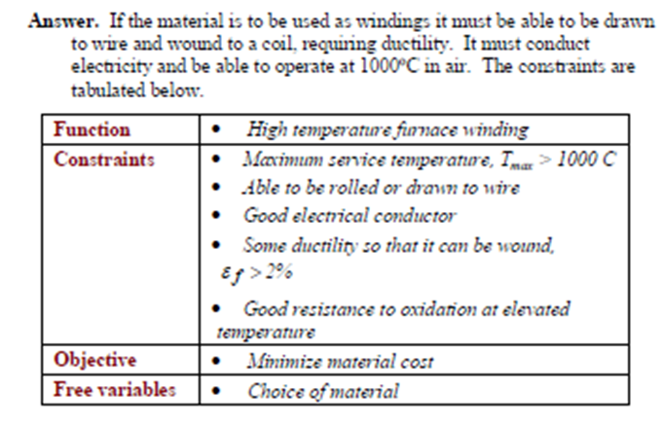

Slide 9
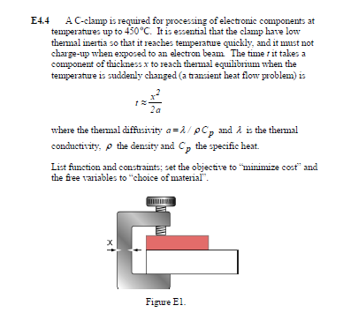

Slide 10

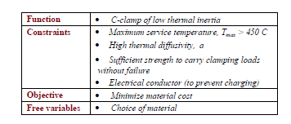

Slide 11
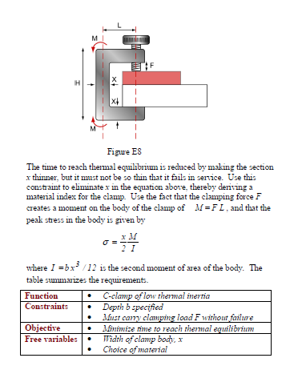
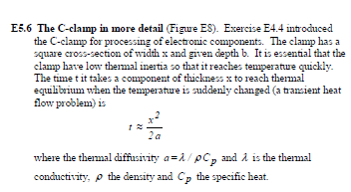
E5: Deriving and using material indices

Slide 12
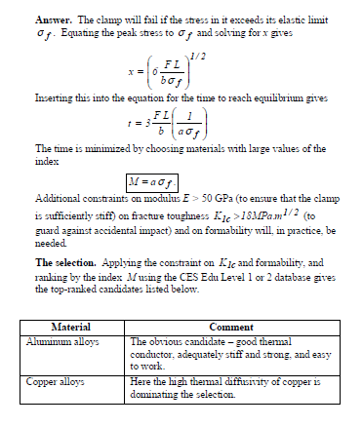

Slide 13
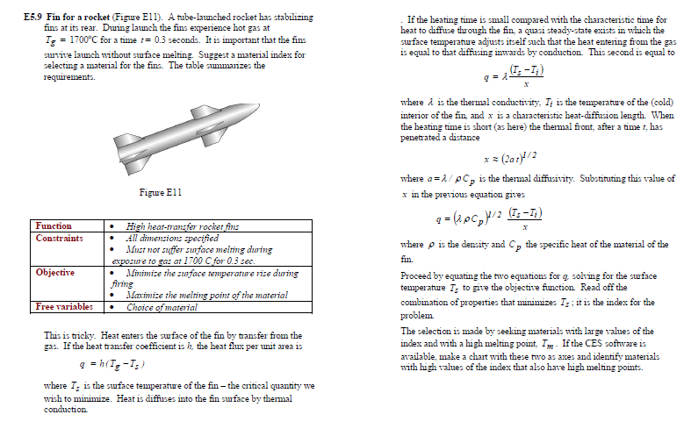

Slide 14
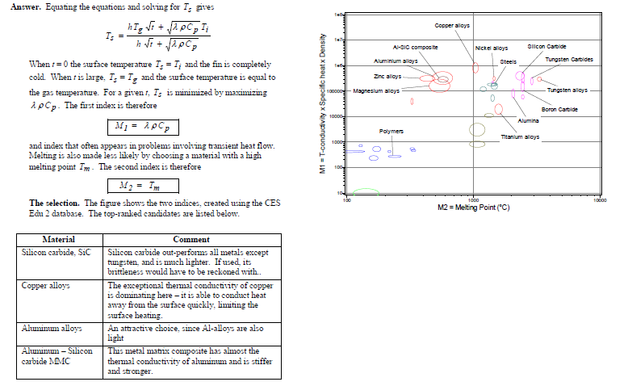

Slide 15
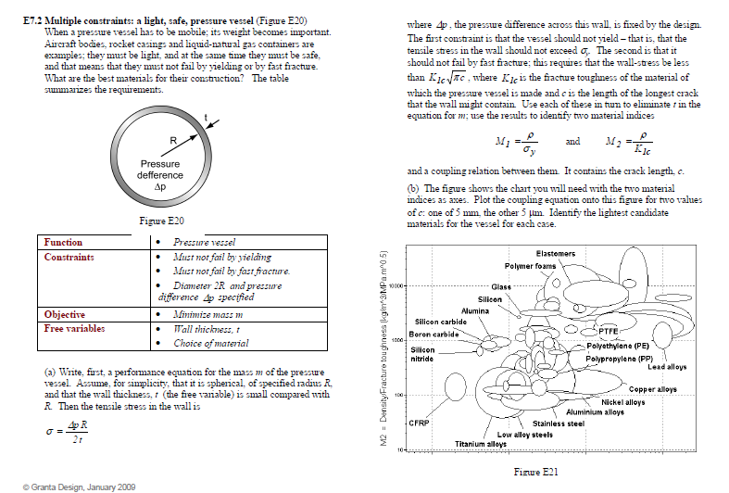
E7: Multiple constraints and objectives

Slide 16
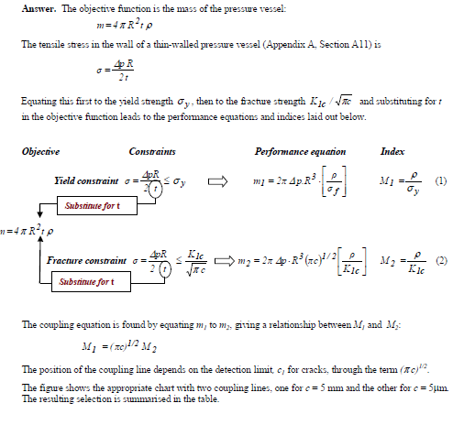

Slide 17
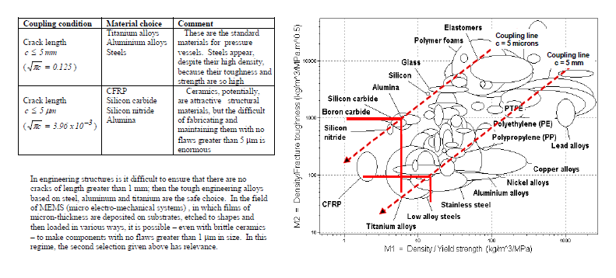

Slide 18
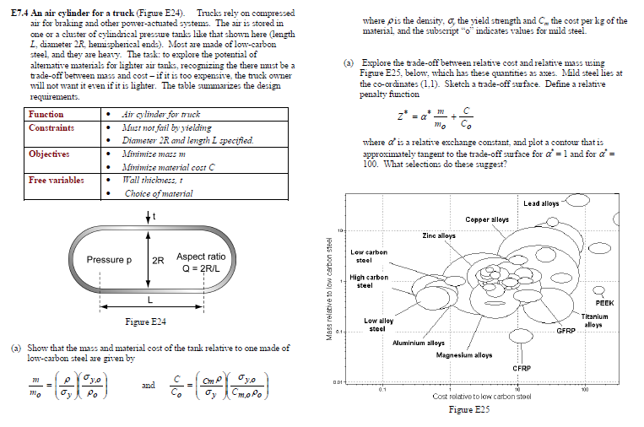

Slide 19
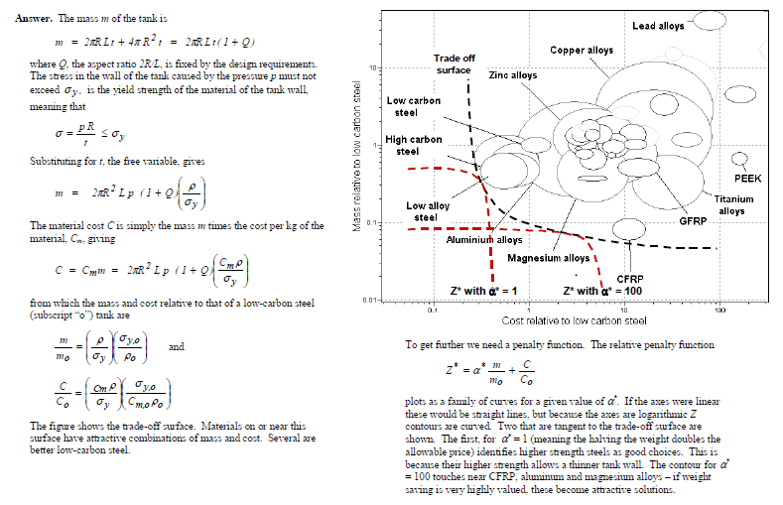

Slide 20
Midterm at 14 of November
5 weeks presentations ( with 2 or 3 persons )
PRESENTATION TITLES
MATERIALS SELECTION INTERIOR PANEL IN AUTOMOTIVES
Materials SELECTION of a (UPPER WING ) Panel in AerospaceS
MATERIALS SELECTION FOR TENNIS RACKETS
MATERIALS SELECTION FOR LUBRICATED JOURNAL BEARINGS
MaterialS SELECTION for a Cryogenic Storage Tank
MATERIALS SELECTION for a Sailing-Boat Mast Component

Slide 21
The requirements for presentations
Introduction
Analysis of functional requirements
Design considerations
Technical requirements
Selection of alternative materials
Comparison of candidate materials
Conclusion

