Slide 1
Exercises 2

Slide 2
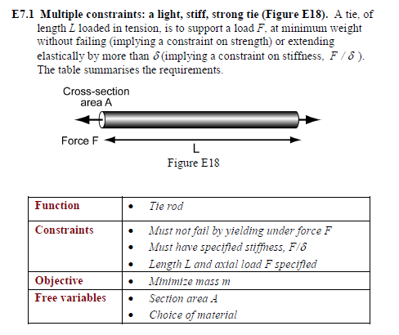

Slide 3
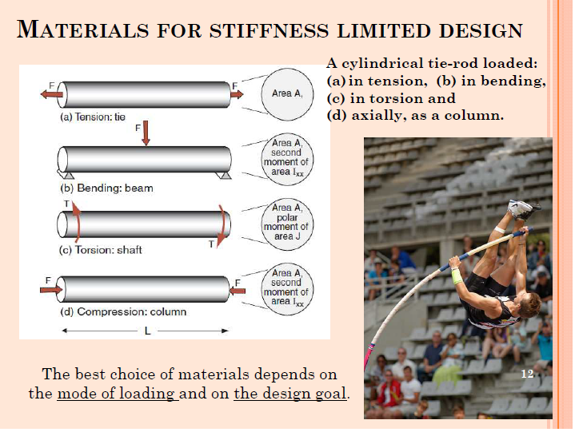

Slide 4
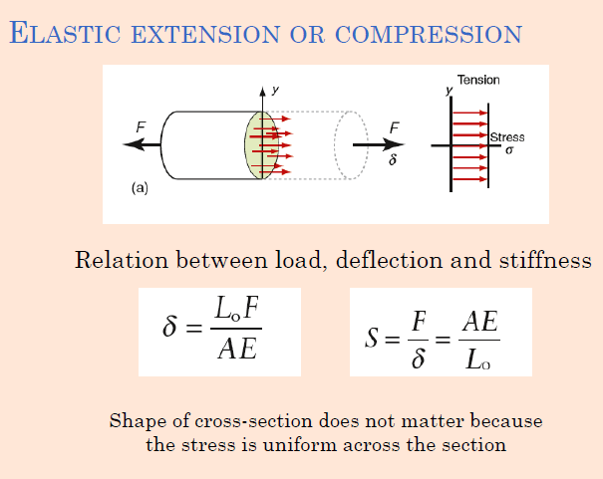

Slide 5
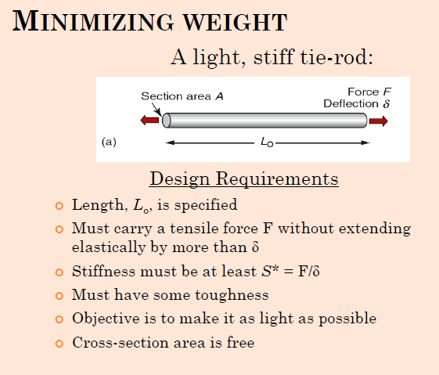

Slide 6
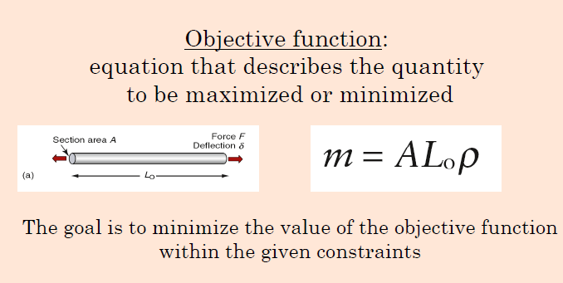


Slide 7
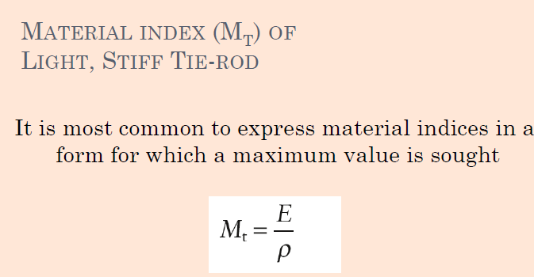

Slide 8
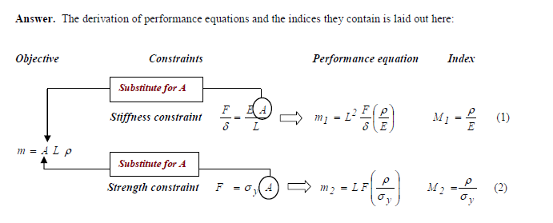

Slide 9


Slide 10
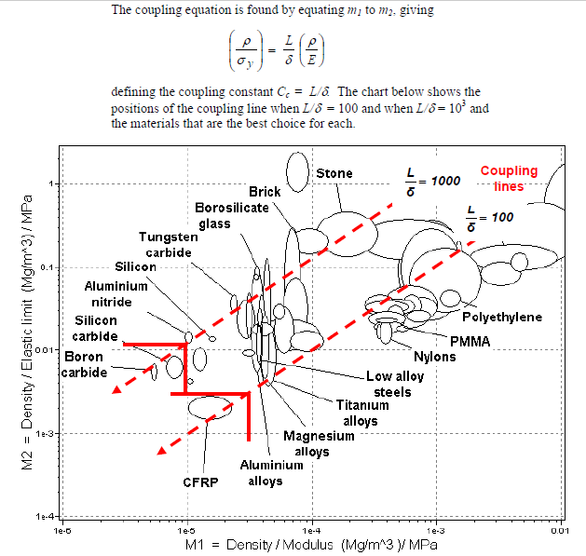

Slide 11
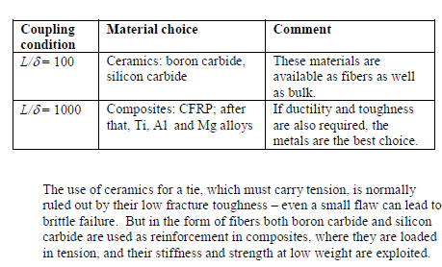

Slide 12
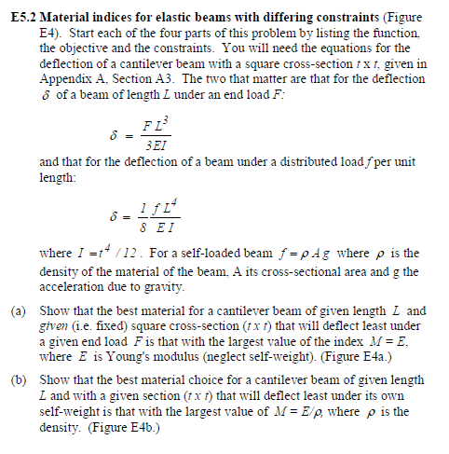
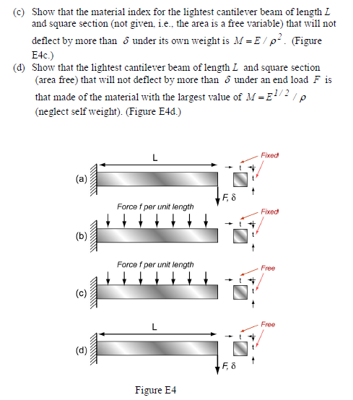

Slide 13
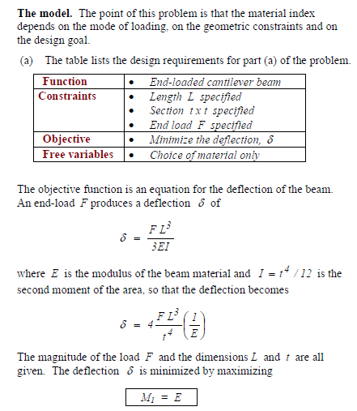
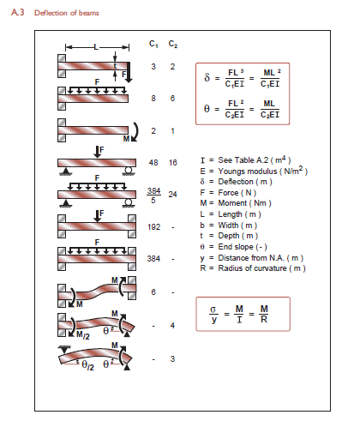

Slide 14
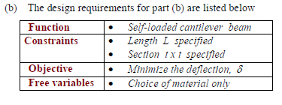
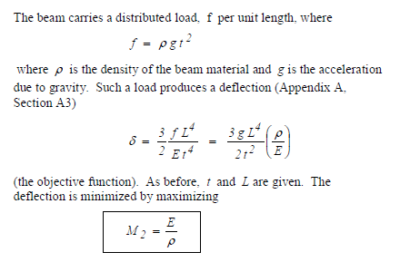

Slide 15
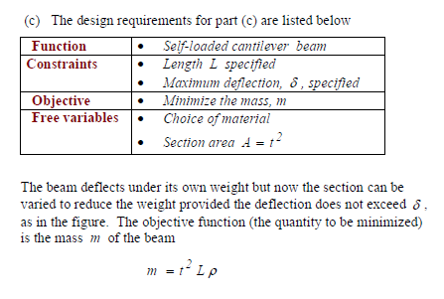
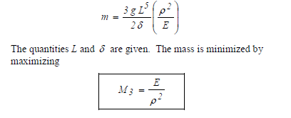

Slide 16
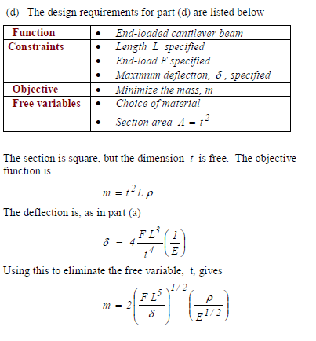
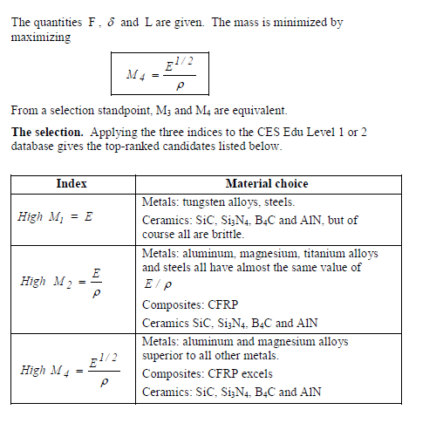

Slide 17
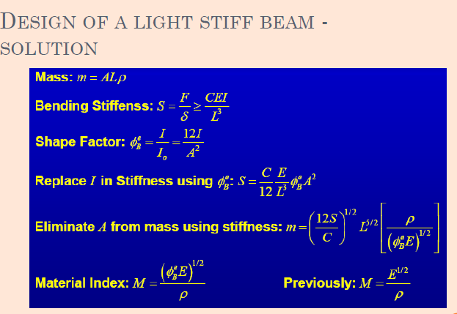

Slide 18
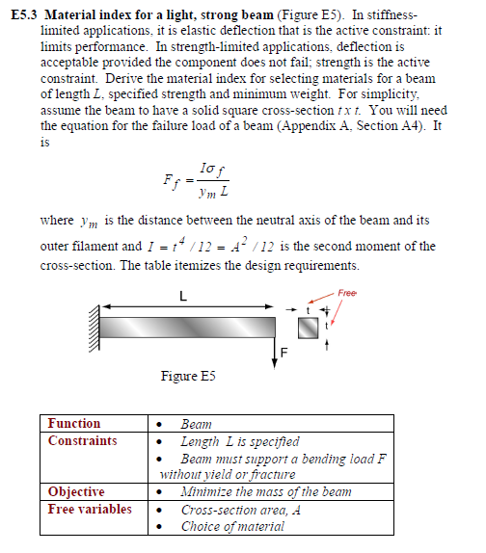
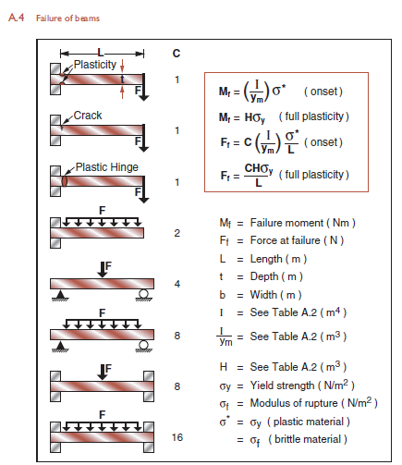

Slide 19
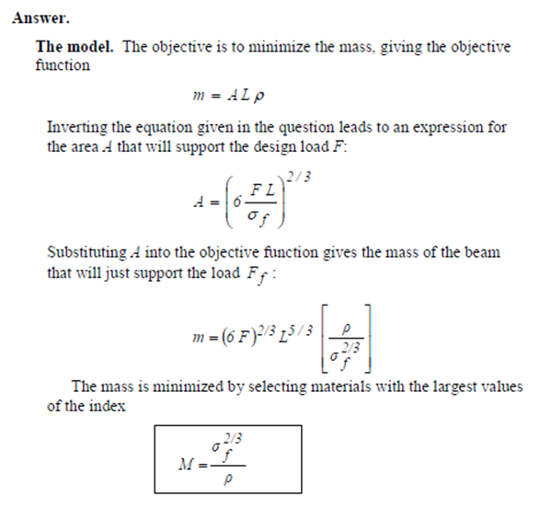

Slide 20
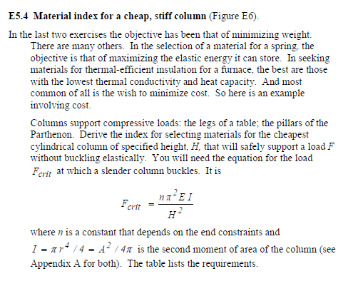
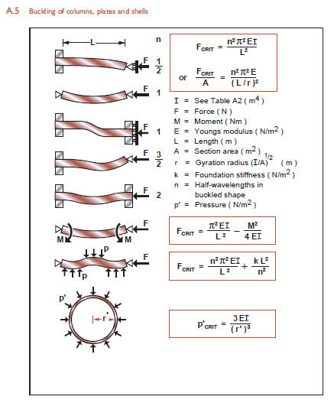

Slide 21
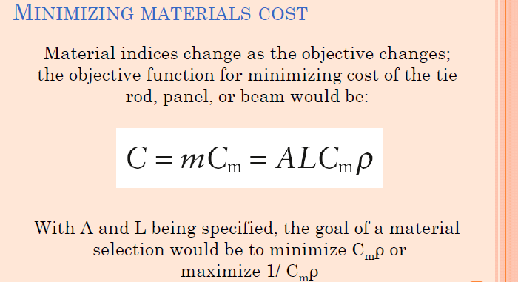

Slide 22
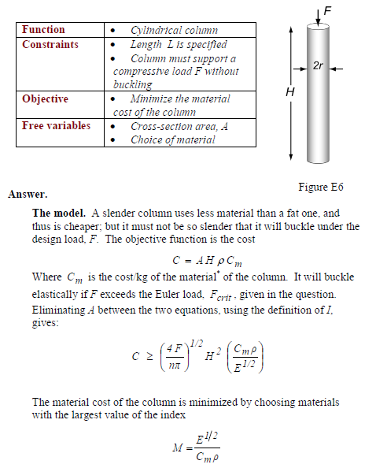
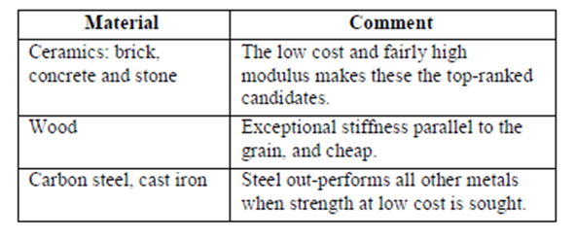

Slide 23
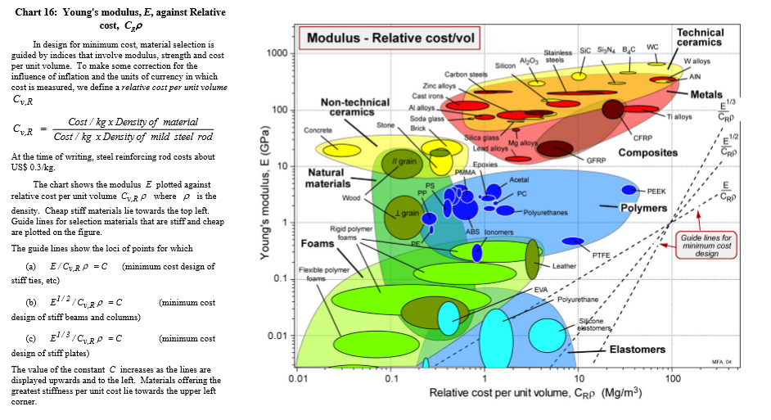

Slide 24
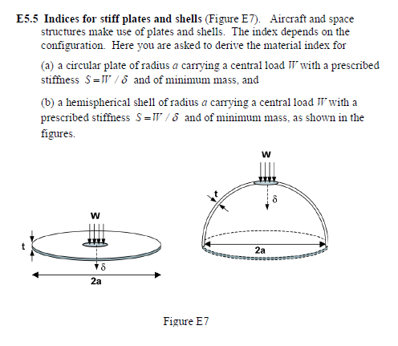
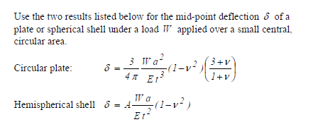

Slide 25
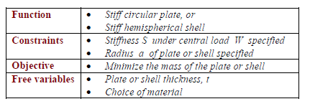
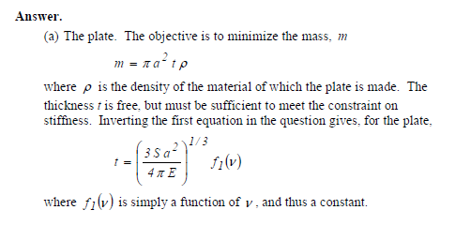
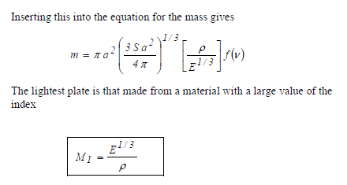

Slide 26
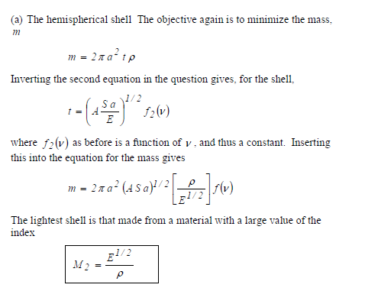

Slide 27

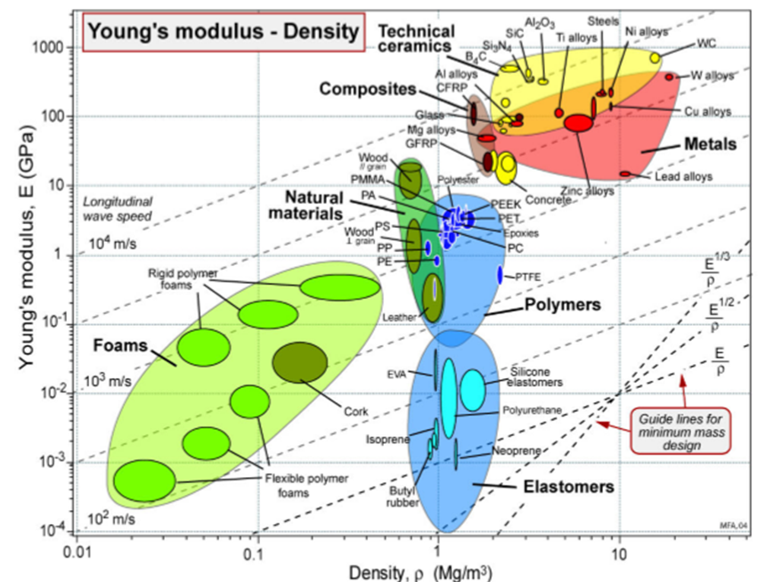
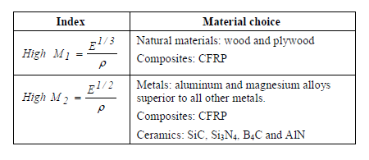

Slide 28
Midterm at 7th of November
5 weeks presentations ( with 2 or 3 persons )
PRESENTATION TITLES
MATERIALS SELECTION INTERIOR PANEL IN AUTOMOTIVES (Sıla Büyükatak/Selin Akkuzu)
MATERIALS SELECTION FOR TENNIS RACKETS (Ayşin Açıkgöz /Tekzen Tügen)
MATERIALS SELECTION FOR LUBRICATED JOURNAL BEARINGS (Görkem Bayri/Berkay Onay/Hikmet Kılıç)
MaterialS SELECTION for a Cryogenic Storage Tank (Can Özdöngül/Buğra Altınel/Mert Dirican)
MATERIALS SELECTION for a Sailing-Boat Mast Component (Gülberk Kıran/Meriç İkiz/Ezgi Yantiri)

Slide 29
The requirements for presentations
Introduction
Analysis of functional requirements
Design considerations
Technical requirements
Selection of alternative materials
Comparison of candidate materials
Conclusion

