Slide 1
MSE
CHAPTER 5

Slide 2
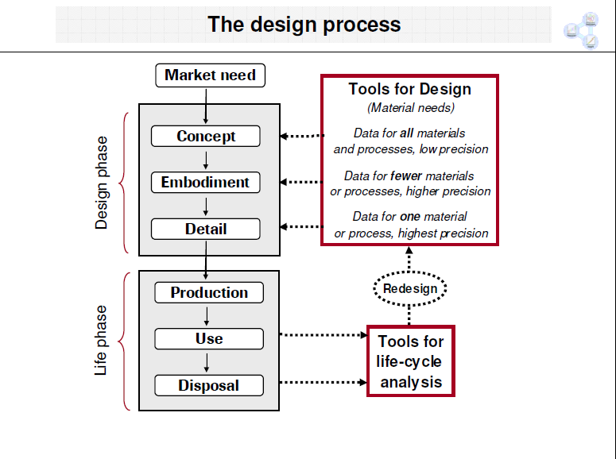

Slide 3
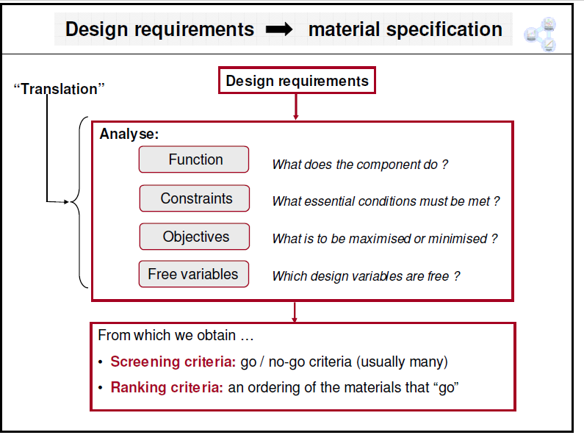

Slide 4
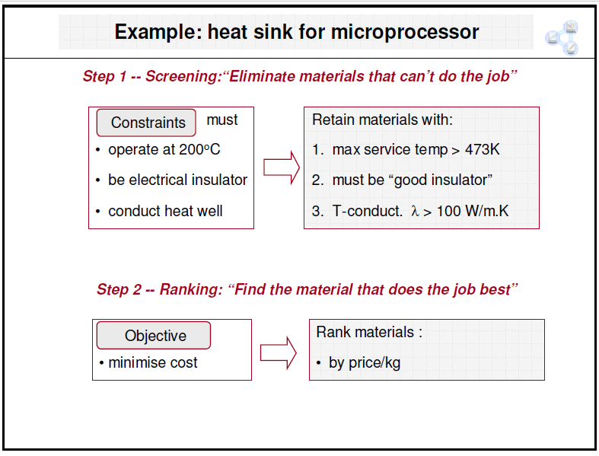

Slide 5
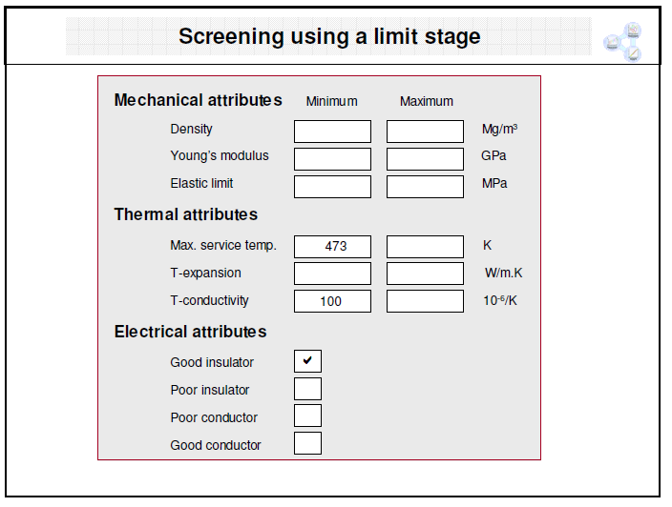

Slide 6
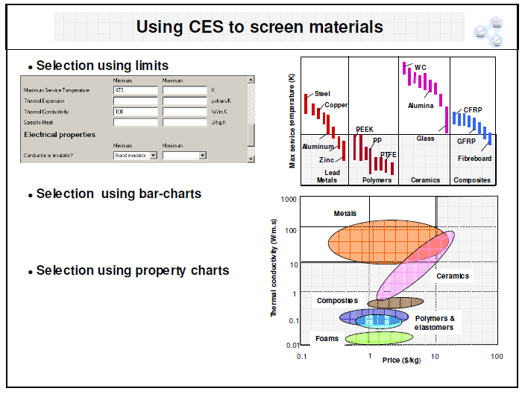

Slide 7
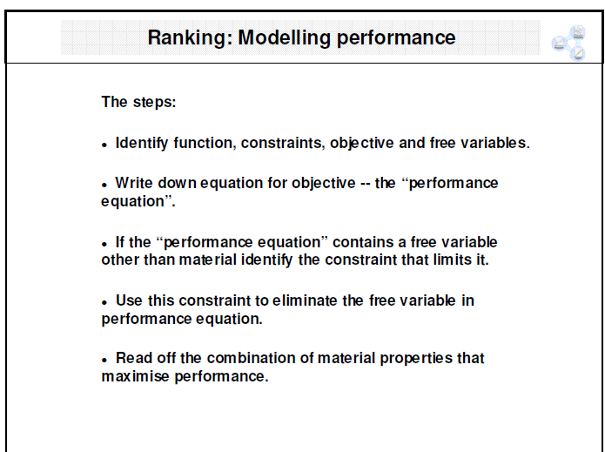

Slide 8
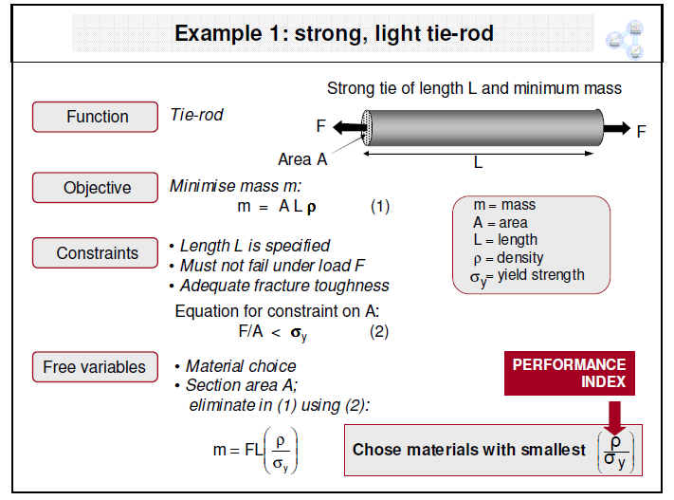

Slide 9
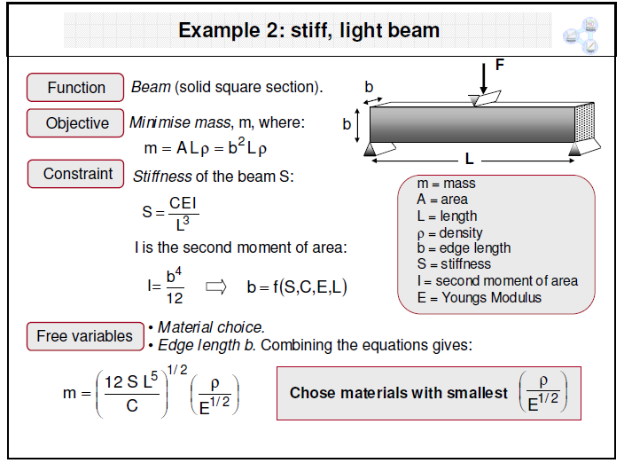

Slide 10
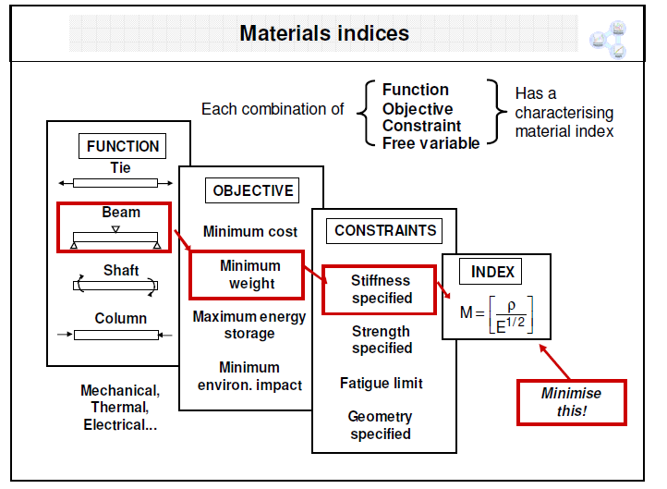

Slide 11
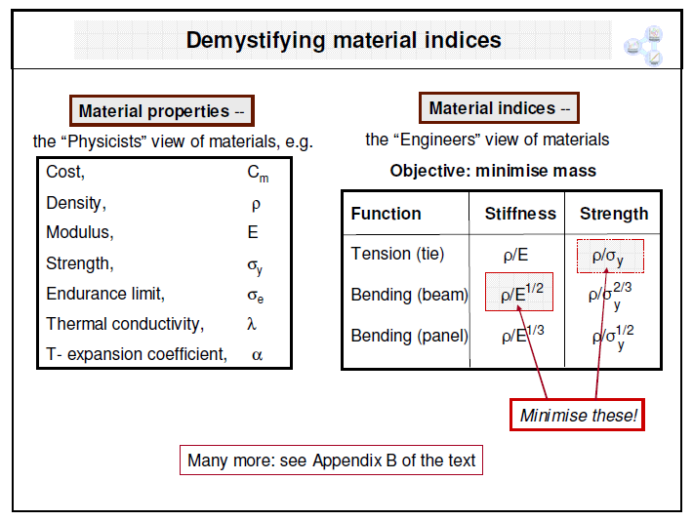

Slide 12
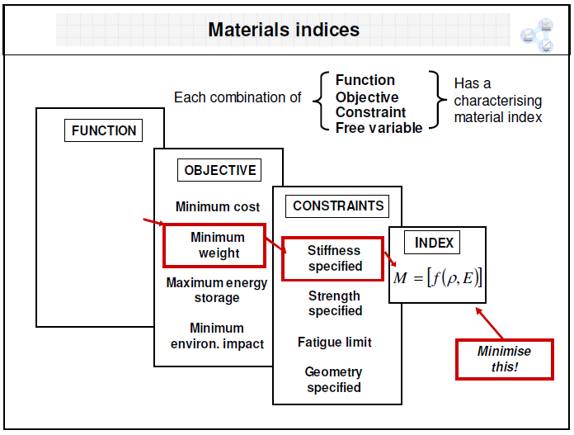

Slide 13
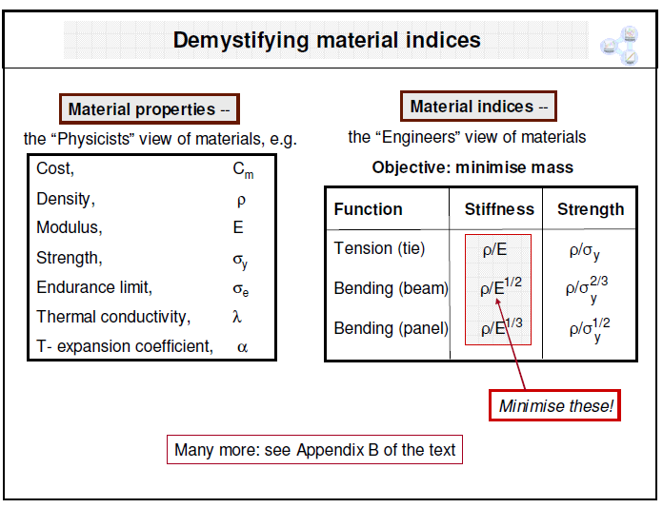

Slide 14
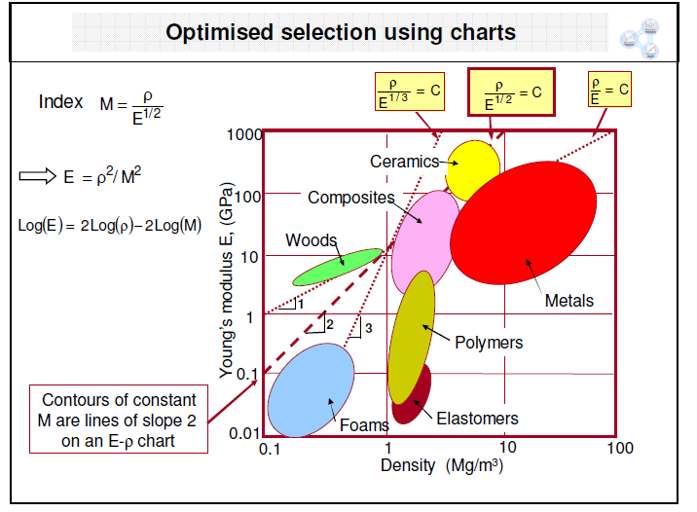

Slide 15
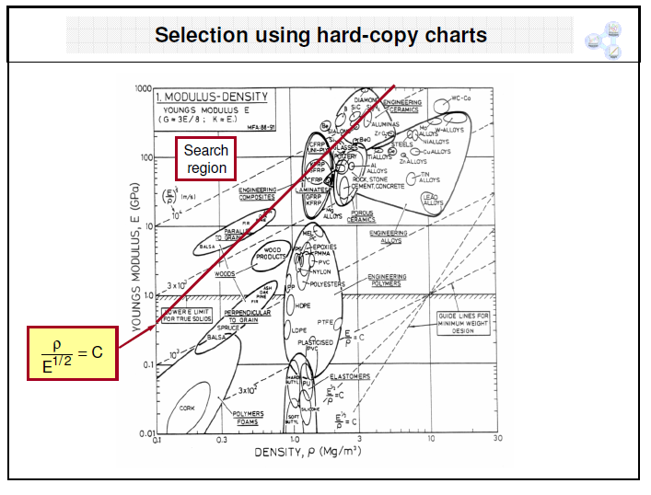

Slide 16
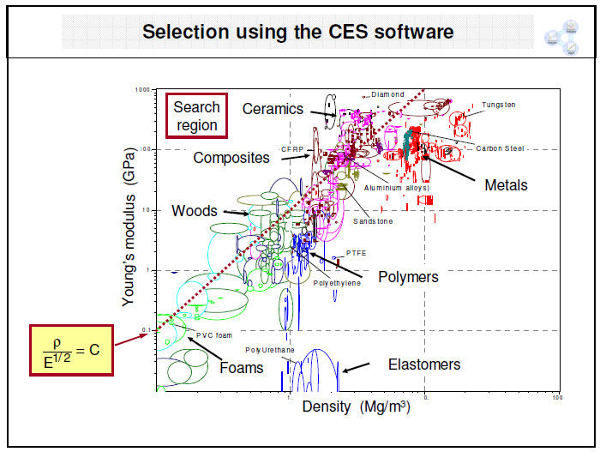

Slide 17
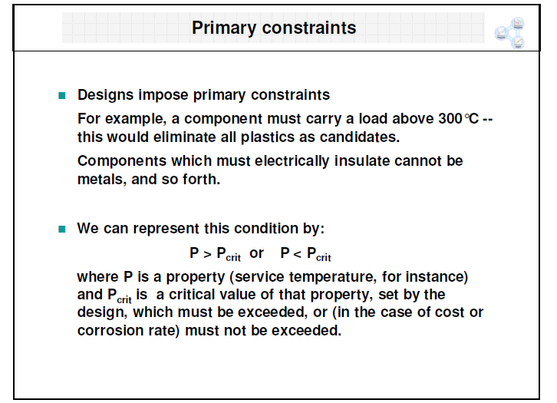

Slide 18
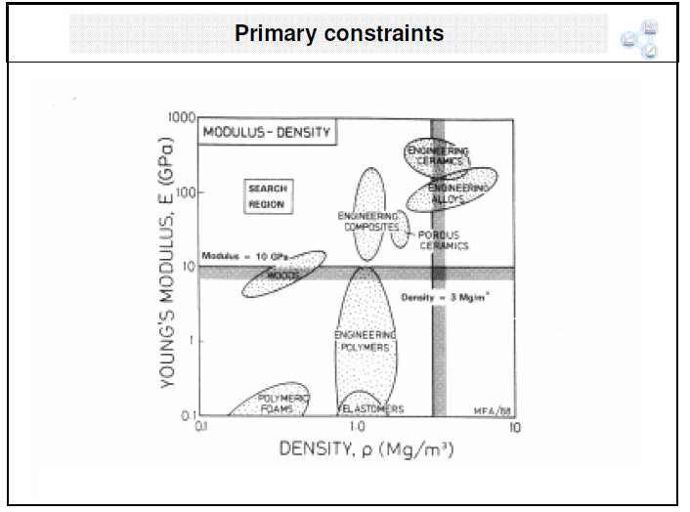

Slide 19
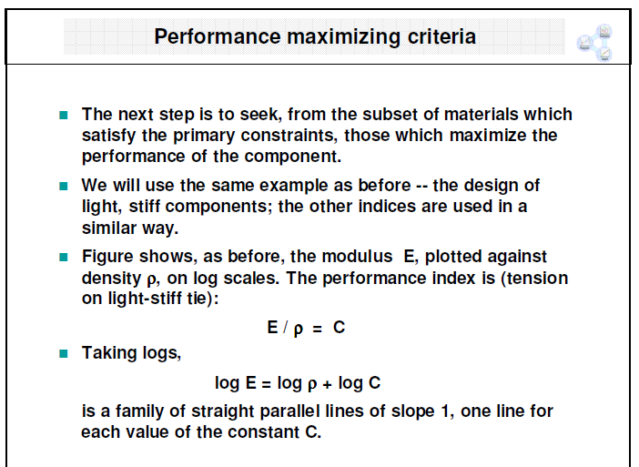

Slide 20
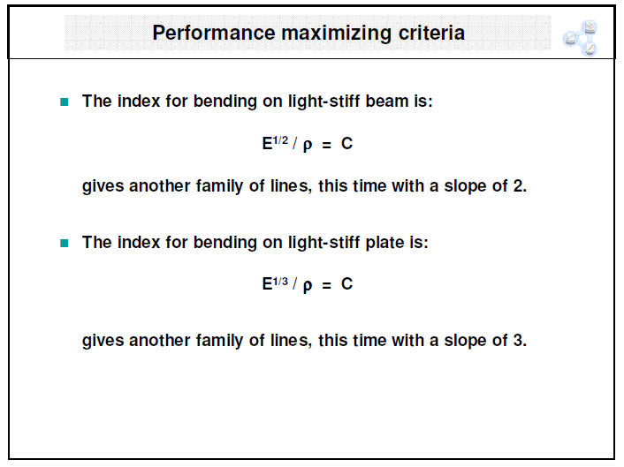

Slide 21
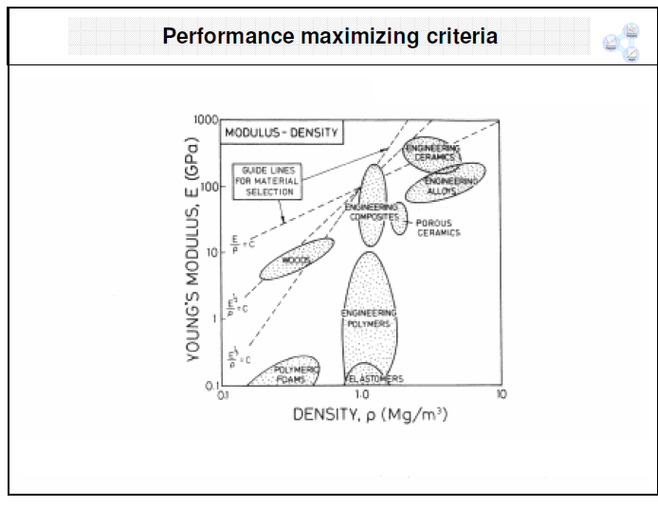

Slide 22
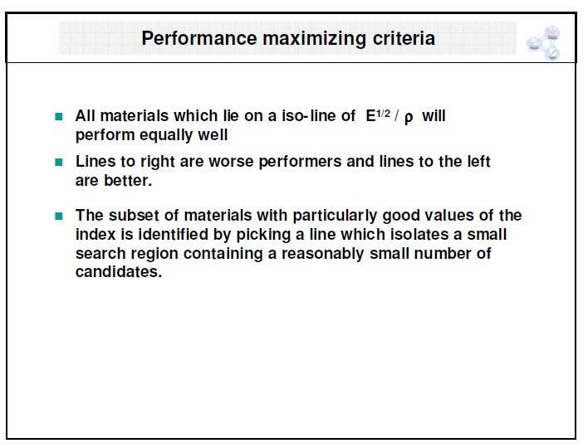

Slide 23
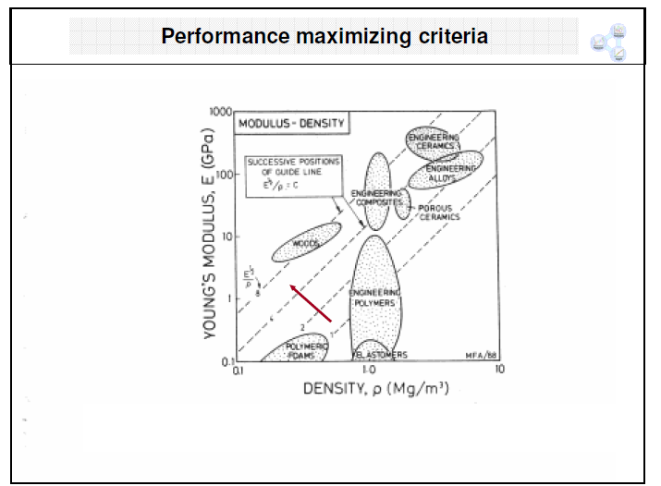

Slide 24
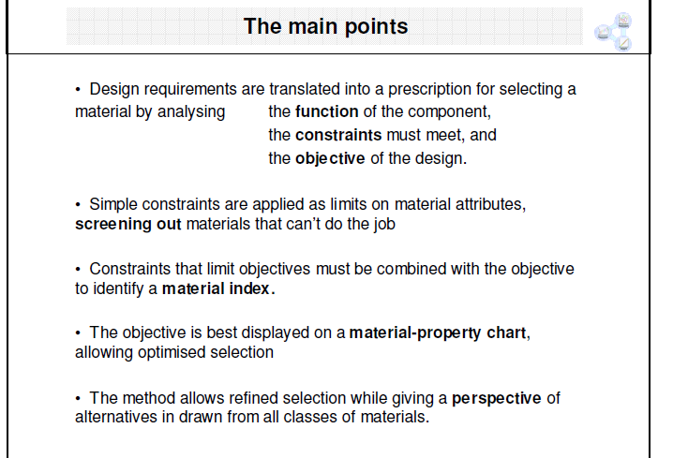

Slide 25
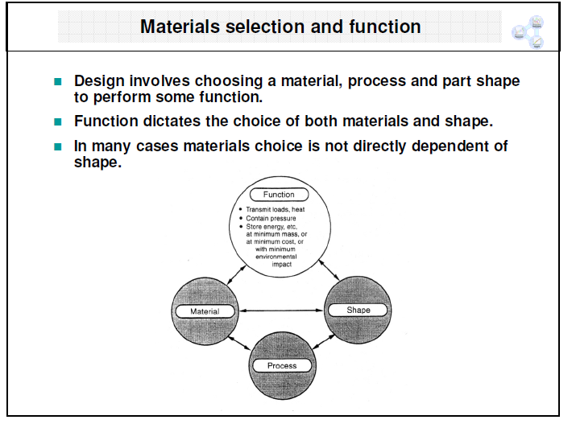

Slide 26
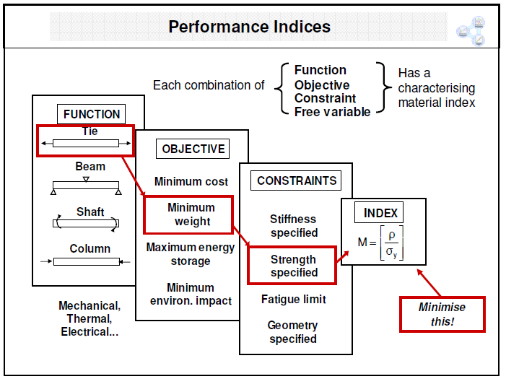

Slide 27
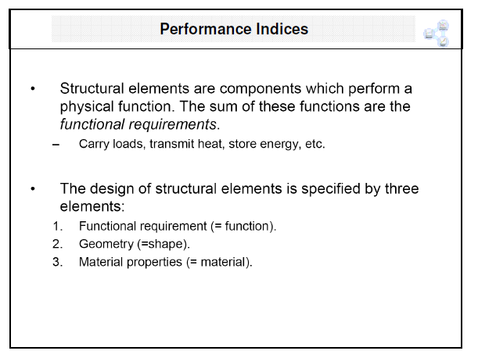

Slide 28
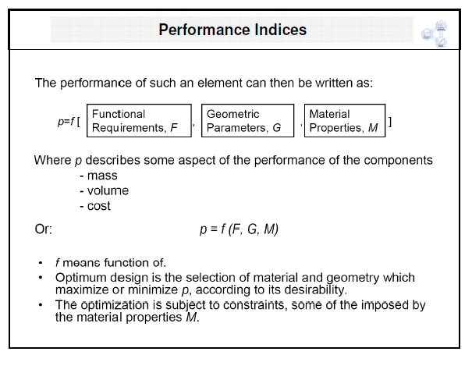

Slide 29
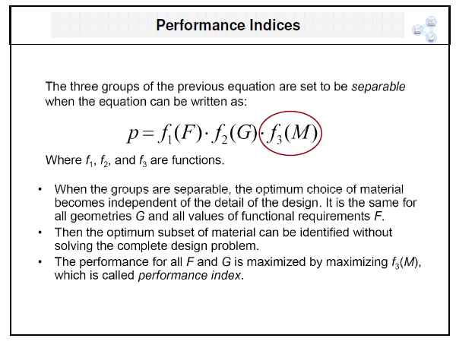

Slide 30
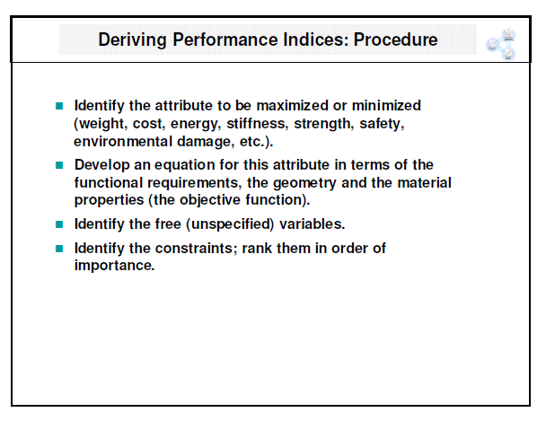

Slide 31
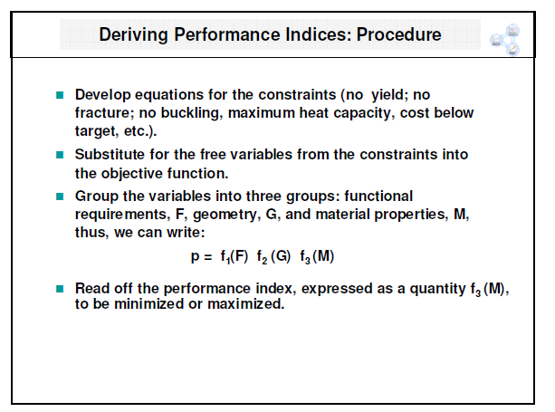

Slide 32
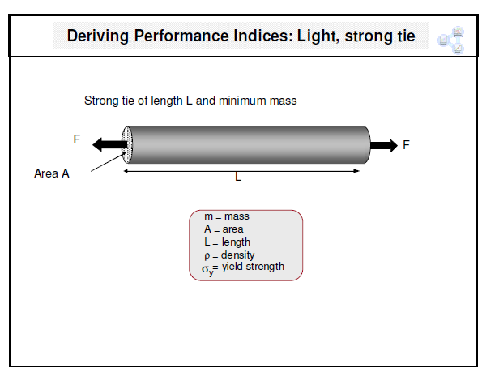

Slide 33
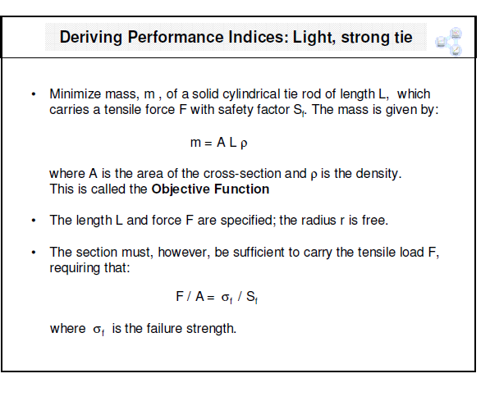

Slide 34
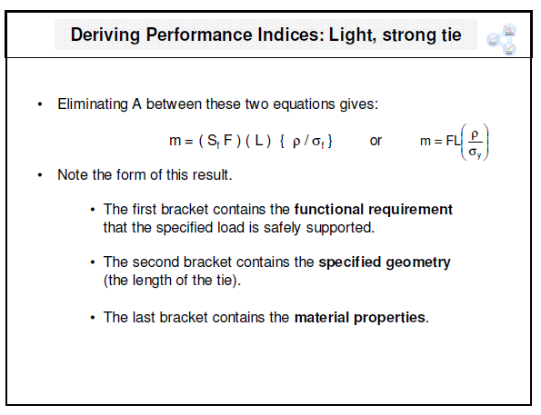

Slide 35
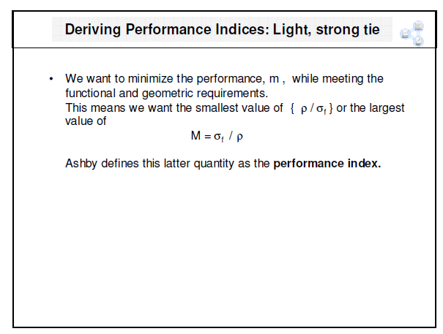

Slide 36
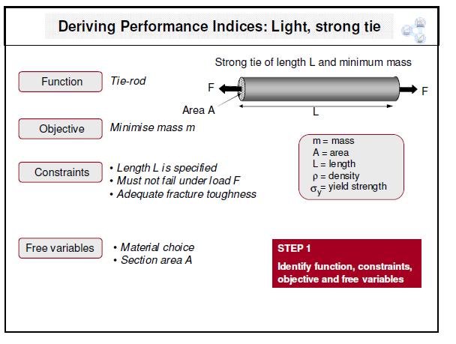

Slide 37
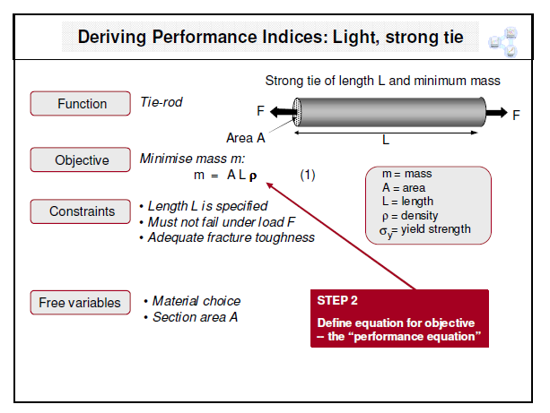

Slide 38
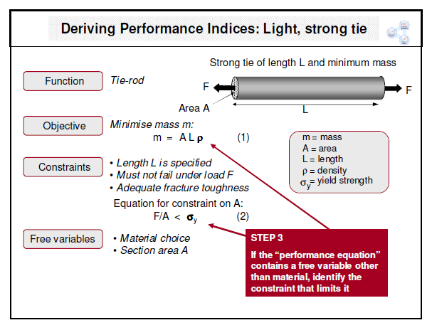

Slide 39
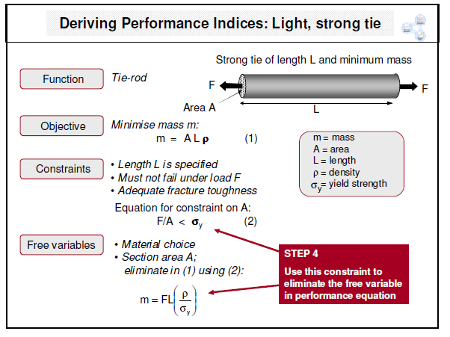

Slide 40
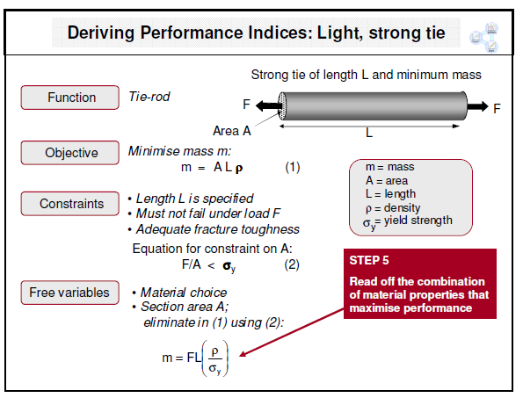

Slide 41
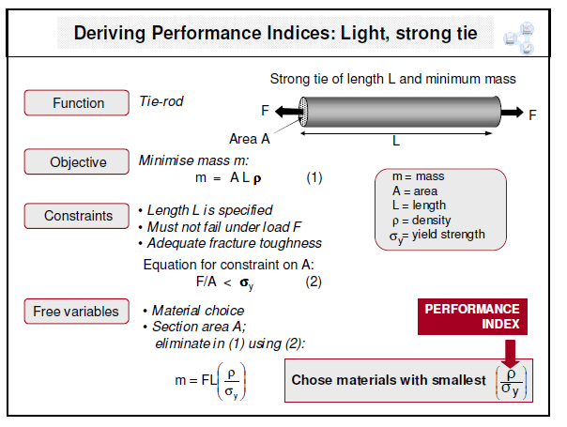

Slide 42
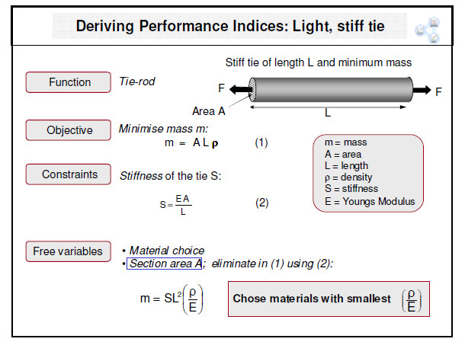

Slide 43
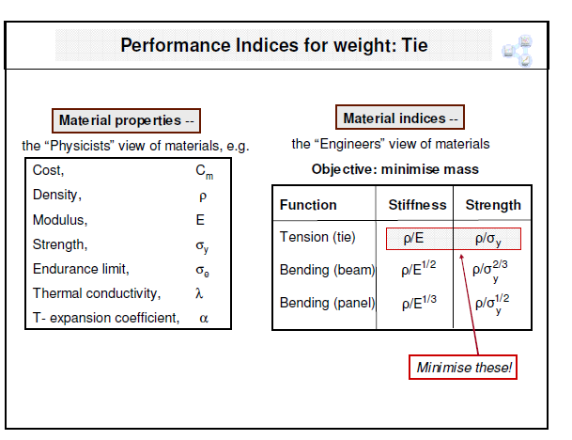

Slide 44
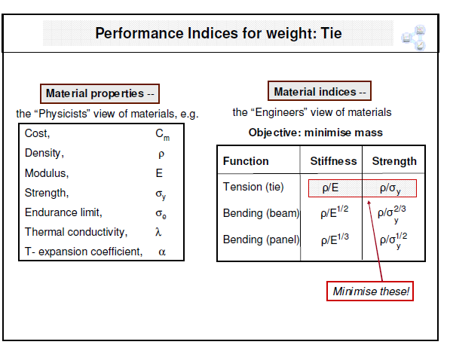

Slide 45
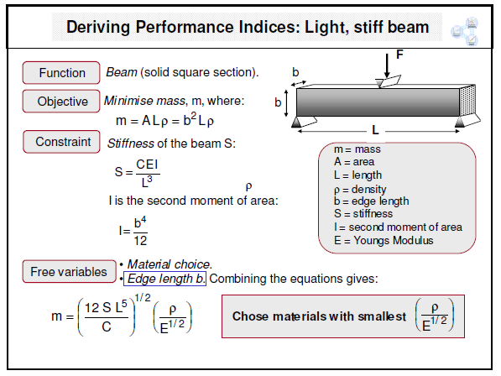

Slide 46
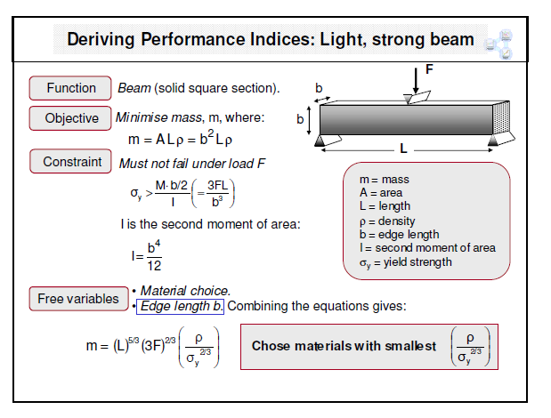

Slide 47
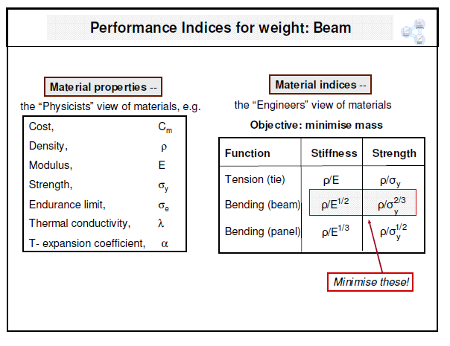

Slide 48
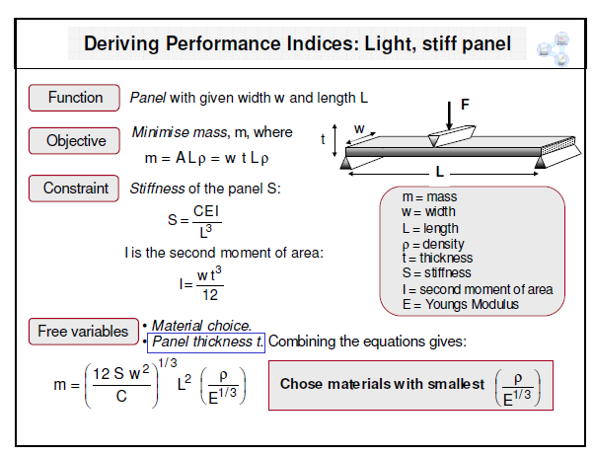

Slide 49
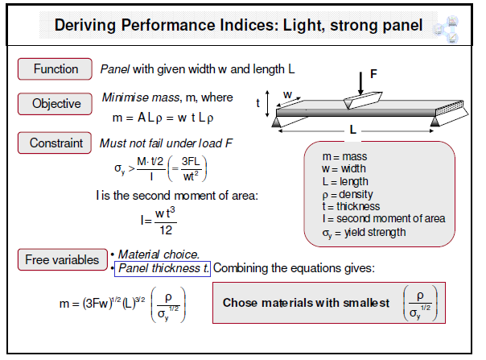

Slide 50
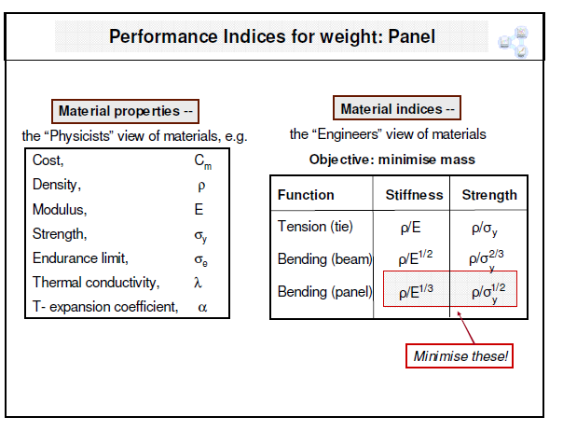

Slide 51
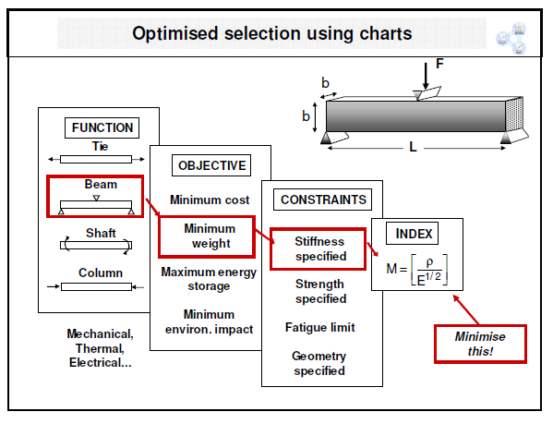

Slide 52


Slide 53


Slide 54


Slide 55


Slide 56


Slide 57


Slide 58


Slide 59


Slide 60


Slide 61

Example Problem: Table Legs
Want to redesign table with thin unbraced cylindrical Legs
Want to minimize cross-section and mass without
buckling
Toughness and cost are factors

Slide 62

Table Legs: Problem Definition
􀂉Function:
Support compressive loads
􀂉Objective:
Minimize mass
Maximize slenderness
􀂉Constraints:
Length specified
Must not buckle
Must not fracture
􀂉Free variables:
Cross-section area
Material

Slide 63

Table Legs: Material indices

Slide 64

Table Legs: Material selection
Eliminated
Metals (too heavy)
Polymers
(not stiff enough)
Possibilities: Ceramics,
wood, composites
Final choice: wood
Ceramics too brittle
Composites too
Expensive
Note: higher constraint
on modulus

Slide 65

Material index 1

Slide 66

Material index 2

Slide 67

Example: Heat-Storing Wall
Outer surface
heated by day
Air blown over
inner surface to
extract heat at
Night
Inner wall must
heat up ~12h after
outer wall

Slide 68

Heat-Storing Wall: Problem Definition
Function:
Heat storing medium
Objective:
Maximize thermal energy
stored per unit cost
Constraints:
Heat diffusion time ~12h
Wall thickness ≤ 0.5 m
Working temp Tmax>100 C
Free variables:
Wall thickness, w
Material

Slide 69

Heat-Storing Wall: Material indices

Slide 70

Heat-Storing Wall: Material Selection
Eliminated
Foams: Too
porous
Metals: Diffusivity
too high
Possibilities:
Concrete, stone,
brick, glass,
titanium(!)
Final Choices
Concrete is
cheapest
Stone is best
performer at
reasonable price

